Slide 1
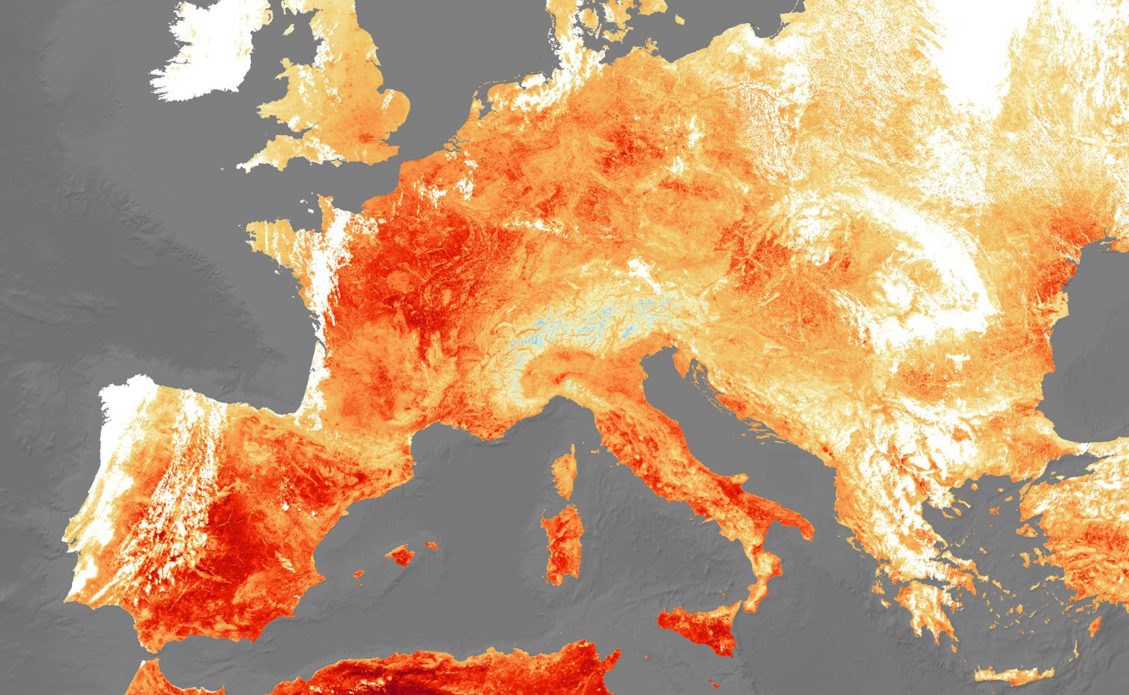
Understanding Climate Change in Europe with Machine Learning
Analysis by Jeremy Obach
30 JUN 24

Slide 2

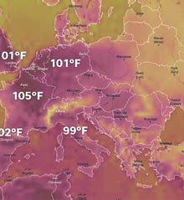
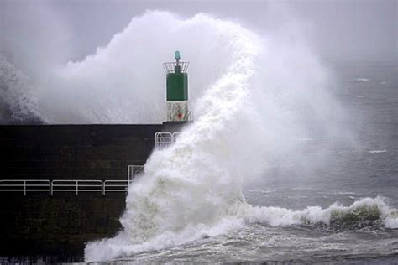

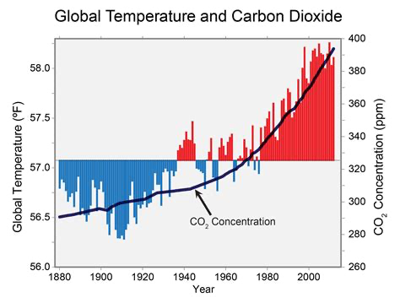
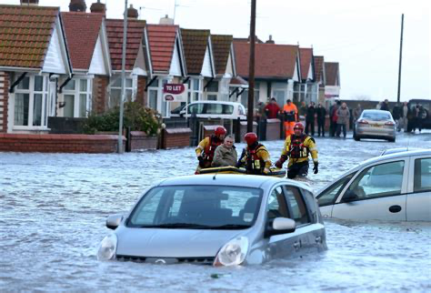
Objectives
Identify weather patterns outside the regional norm in Europe.
Determine if unusual weather patterns are increasing.
Generate possibilities for future weather conditions over the next 25 to 50 years based on current trends.
Determine the safest places for people to live in Europe over the next 25 to 50 years.

Slide 3
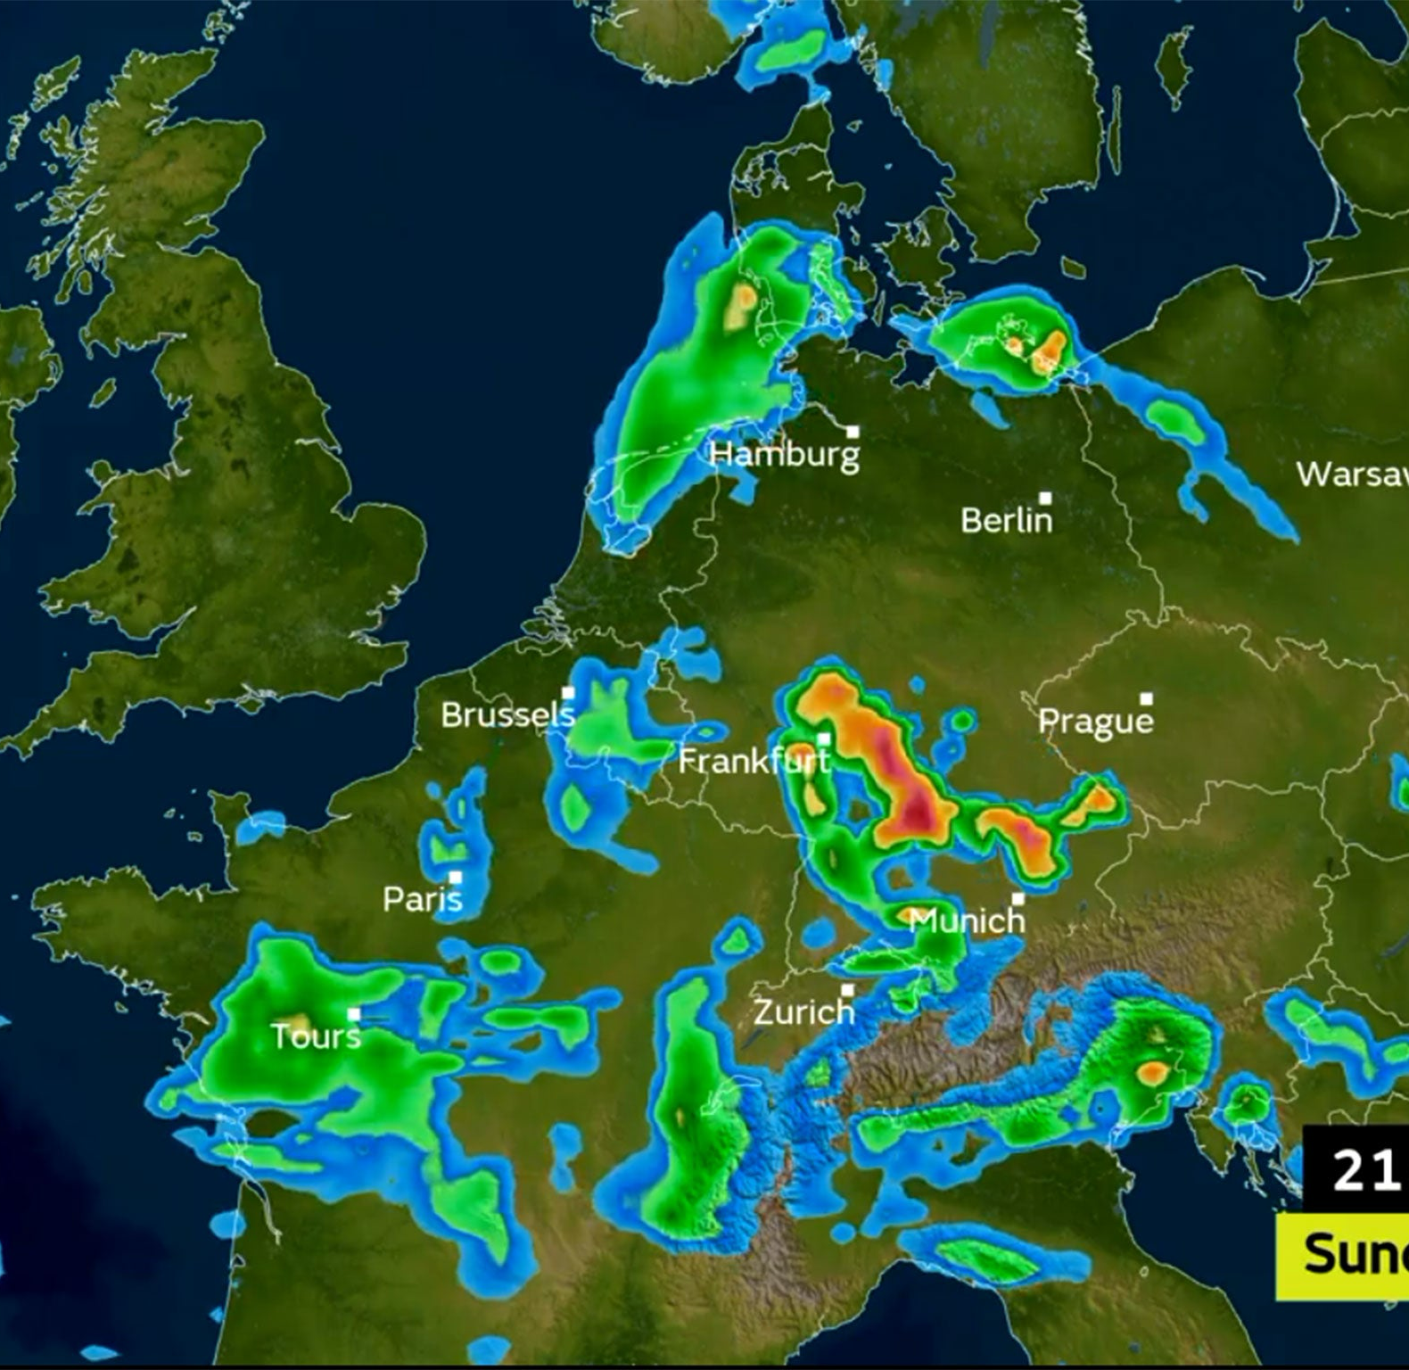
Thought Experiments
Suppose a machine-learning model was powerful enough to predict the weather with 100 percent accuracy for the next 25-50 years – BUT the energy consumption required for the operation of this model has a significant detrimental effect on the climate.
1) To what extent could the model’s operation be justified based on insights garnered?
2) How can we determine the maximum prediction benefit for the minimum climate detriment?
Could a model use the migration data of human history to optimally place climate refugees in new nations?
3) How should nations distribute the brunt of climate displacement/humanitarian aid?
Notes:
Essentially to know the future would, to some extent, doom it.

Slide 4
Machine Learning Models
Convolution Neural Network
- great for image recognition tasks
Recurrent Neural Network
- excellent for sequence recognition problems
Random Forest
- versatile, handles large datasets well
- Excels at sorting
Regression Analysis
- Simple, interpretable, great for trends
Principal Component Analysis
-Dimensionality reduction, feature extraction.
Hyperparameter optimization
- Enhances model performance, efficiency.
Notes:
Sure, here are brief descriptions for each:
- **Convolutional Neural Network (CNN):** Great for image recognition tasks.
- **Recurrent Neural Network (RNN):** Excellent for sequence prediction problems.
- **Random Forest:** Robust against overfitting, ensemble method, versatile, handles large datasets well
- **Regression Analysis:** Simple, interpretable, great for trends.
- **Principal Component Analysis (PCA):** Dimensionality reduction, feature extraction.
- **Hyperparameter Optimization:** Enhances model performance, efficiency.

Slide 5
Data Needs
Weather data for Europe
18 weather stations from our study + representative weather samples to fill out underserved zones
Metrics including temperature, precipitation, wind strength, etc.
Weather data for Earth
Advanced models could utilize satellite and radar for a more comprehensive understanding of weather patterns.
- Destructive weather events – Measure of land viability with heightened sea levels.
Migration data
Tracking population growth and decline of various groups, some measure of successful vs unsuccessful integration
Miscellaneous “Big Data”
- Energy sources for ML Model operation
- Pollution sources
- Human conflict and political situations
- Ozone status, solar radiation measurements
Notes:
Hypothetical “big data” doesn’t need to be all information ever. Make it more specific:
Energy sources for ML model, World weather systems, pollution sources, political situations, human conflict etc.

Slide 6
Scenario 1
Thought Experiment: A ML weather model that damages the environment.
ClimateWins Objectives:
Identify weather patterns outside the regional norm in Europe.
ML Models
Regression Analysis
Principal Component Analysis
Hyperparameter Optimization
Data Required
ML algorithm operation cost data
- Hardware requirements
- Usage rate
- Electricity source
i.e., Coal, wind, solar
- Heat expenditure
Weather Data
- impact of heat and energy expenditure from said operation.
How can we determine the maximum prediction benefit for the minimum climate detriment?
Determine if unusual weather patterns are increasing.
Notes:
Edit-
Data Required: should reflect the emphasis on operation of the model/ Machine Usage rather than the weather data.
Weather data for Europe
18 weather stations from our study
Representative weather samples to fill out underserved zones
Weather data for Earth
Advanced models could utilize satellite and radar for a more comprehensive understanding of weather patterns.

Slide 7
Scenario 2
A ML weather model that damages the environment
What insights could we draw from a complete knowledge of the next 50 years of weather, and would it be enough to offset the operation of the model?
ClimateWins Objectives
Identify weather patterns outside the regional norm in Europe.
ML Models
Convolution Neural Network/ Recursive Neural Network
Both use supervised and unsupervised learning to make connections, like the brain.
Data
Hyperparameter optimization
Bayesian, Random, Search
Misc. “big data” to fill in the predictive model, approach hypothetical “100% predictive accuracy”
Weather data for Europe/ Earth
Determine if unusual weather patterns are increasing.
Generate possibilities for future weather conditions over the next 25 to 50 years based on current trends.
Notes:
Scenario 2 – emphasize the weather prediction aspect instead of the ML operation cost aspect (which is the focus of Scenario 1)
Focus the Data and the Scenario.

Slide 8
Scenario 3
Thought Experiment: A ML model to optimize Climate Refugee Placement
How should nations distribute the brunt of climate displacement/humanitarian aid?
ClimateWins Objective:
Determine the safest places for people to live in Europe over the next 25 to 50 years.
ML Models:
Random Forest – especially useful for categorical/sorting problems
PCA – reduce variables to include most important markers of success for refugee integration
Data
Migration data
Tracking population growth and decline of various groups, some measure of successful vs unsuccessful integration.
Region viability assessment for refugees: food and shelter, economic opportunity, proximity to familiar culture, hostility/receptiveness from host nation.
Based on relative economic strength? Availability of shelter/inhabitable land?
Notes:
List Problems/Solutions with PII

Slide 9
Scenario Assessments
Thought Experiment #1 is the most achievable.
Thought Experiment #2 is the most ambitious.
Thought Experiment #3 has the most political implications.
Notes:
Can we do this
Lets do this

Slide 10

Recommended Approach
Scenario 1 can be meaningfully explored to achieve ClimateWins stated goals with current technology and without catastrophic environmental damage
Optimization thru Regression Analysis and PCA, and Hyperparameter analysis.
Can analyze past weather data to assess historical conditions, detect if extreme weather is increasing across Europe.

Slide 11
Questions?
Contact me at Jeremy.Obach@gmail.com
LinkedIn: https://www.linkedin.com/in/jeremy-obach/
Portfolio Website: jobachone.github.io

